Slide 1
Employee Salary Prediction using Gradient Boosting Classifier
CAPSTONE PROJECT
Presented By:
Name- SAKARAPALLI PAVANI
Collage Name- Vivekandha P.G collage(MCA)
Registration ID- STU6837fc16c39781748499478

Slide 2
OUTLINE
Problem Statement (Should not include solution)
System Development Approach (Technology Used)
Algorithm & Deployment (Step by Step Procedure)
Result
Conclusion
Future Scope(Optonal)
References

Slide 3
Problem Statement
This project focuses on predicting whether an employee earns more than $50K annually based on various demographic and occupational factors using the UCI Adult dataset. The data undergoes cleaning, encoding, scaling, and is used to train a Gradient Boosting Classifier, which achieved 86% accuracy . Visualizations such as boxplots and correlation heatmaps aid in data understanding, while model comparison helps validate Gradient Boosting’s superior performance. The final trained model is saved and deployed via a Streamlit web app, enabling both single and batch predictions with downloadable results — making it practical for real-world HR analytics.

Slide 4
System Approach
The "System Approach" section outlines the overall strategy and methodology for developing and implementing. Here's a suggested structure for this section:
System requirements - Python 3.x - Jupyter Notebook or Google Colab
Library required to build the model - pandas for data handling - NumPy for numerical operations - matplotlib and seaborn for visualization - scikit-learn for preprocessing and modeling

Slide 5
Algorithm & Deployment
Import required libraries (pandas, numpy, seaborn, scikit-learn)
Load dataset (adult.csv) into a pandas DataFrame
Replace ‘?’ with ‘NaN’ and drop missing or irrelevant data
Perform EDA using boxplots and correlation heatmap
Encode categorical variable using OneHotEncoder
Scale numerical variables using StandardScaler
Split dataset into training and testing sets (80-20 split)
Build a preprocessing + modelling pipeline using ColumnTransformer and GradientBoostingClassifier
Train the model on training data
Evaluate the model using accuracy score, classification report, and confusion matrix
Plot top 15 most important features learned by the model
Compare performance with other models(KNN, Logistic Regression, Decision Tree)
Save the trained model using joblib
Deploy the model in a web app using Streamlit for real-time predictions

Slide 6
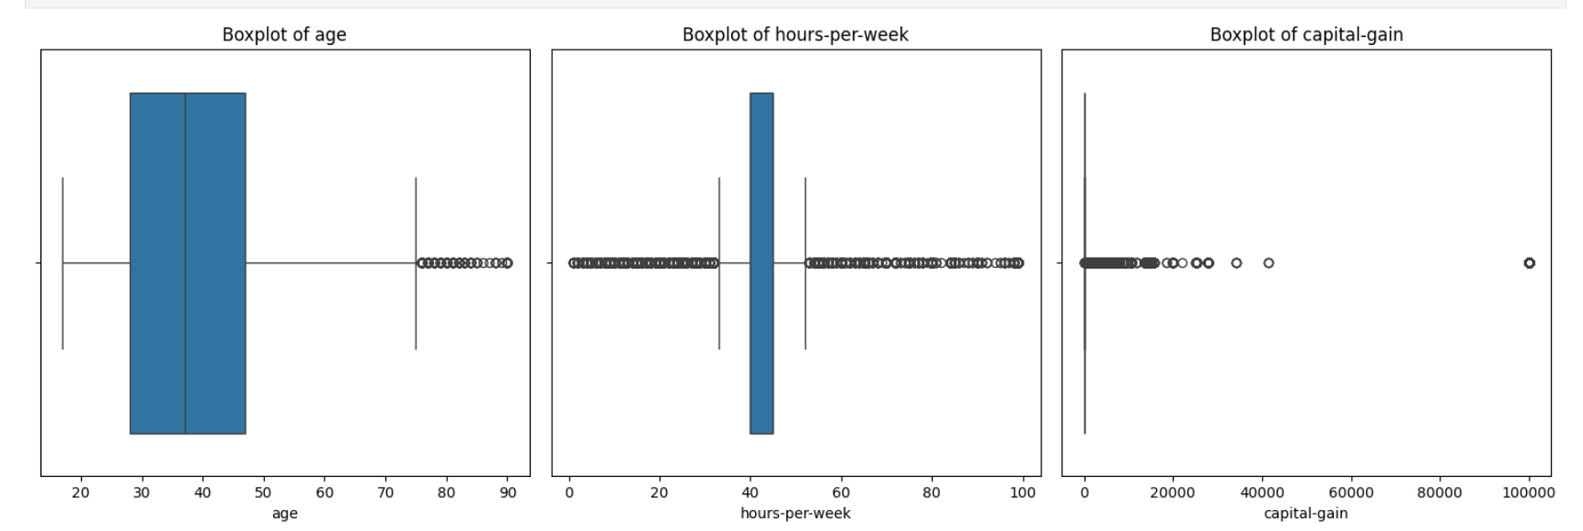
Result

Slide 7
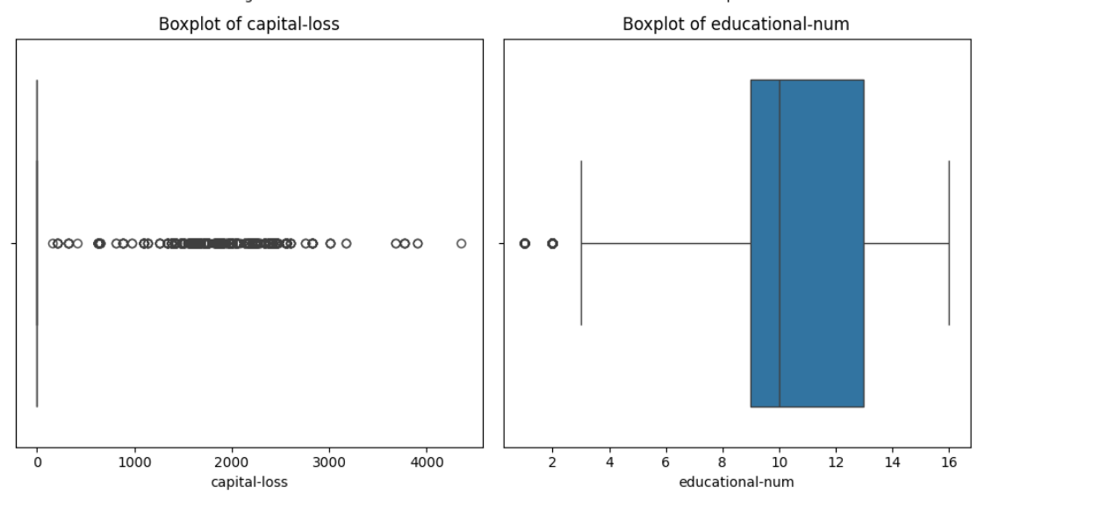

Slide 8
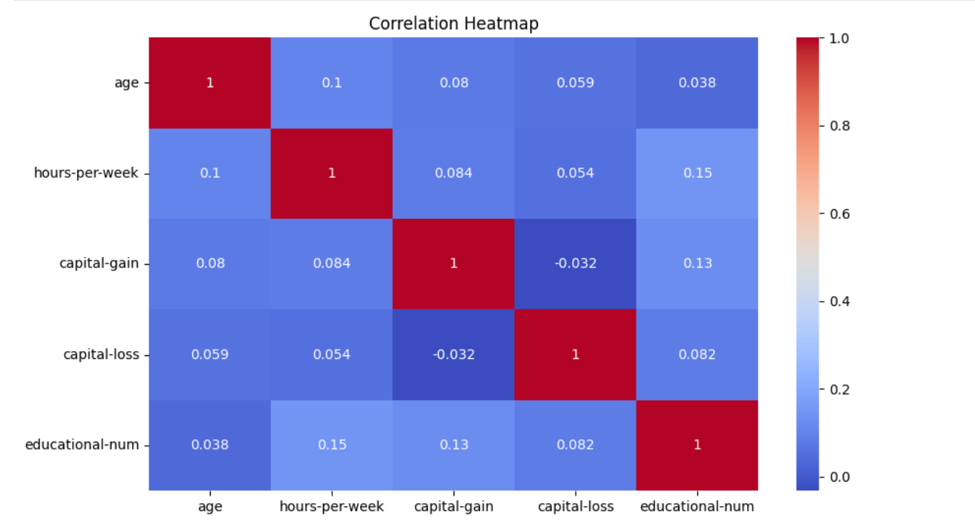

Slide 9
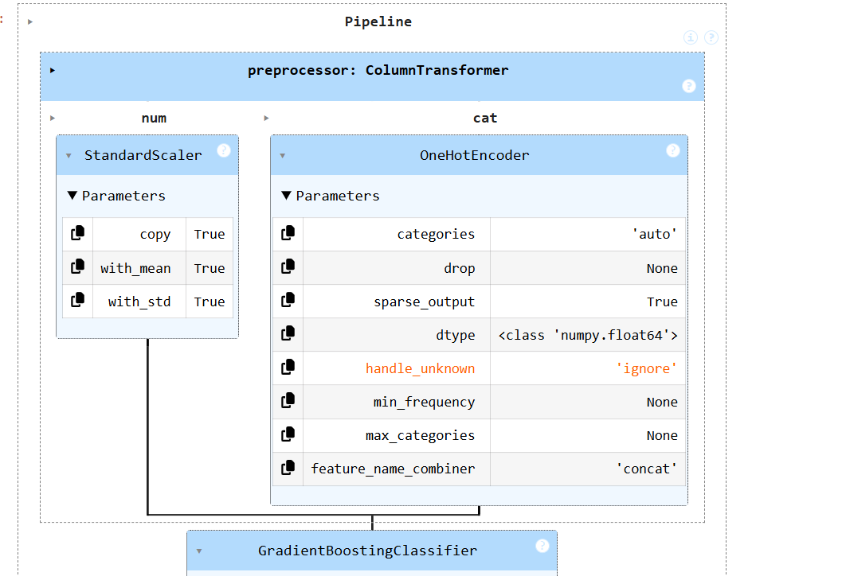

Slide 10
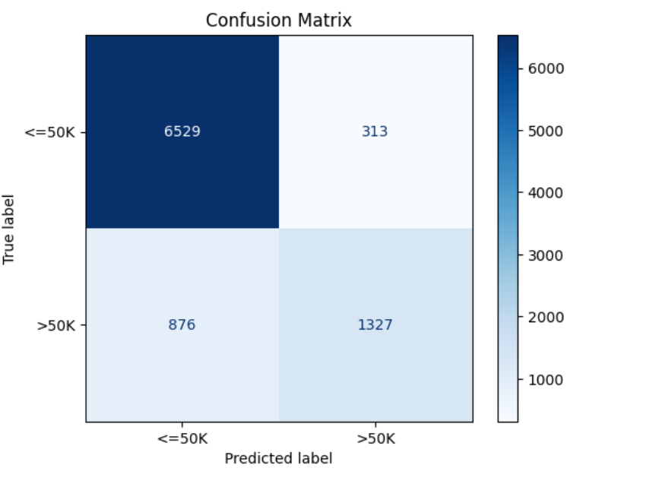

Slide 11
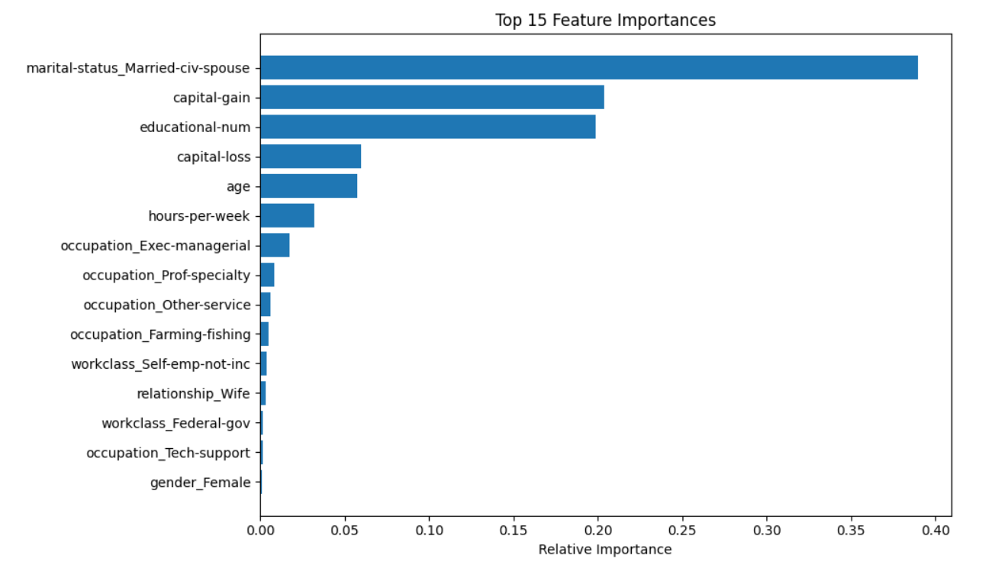

Slide 12
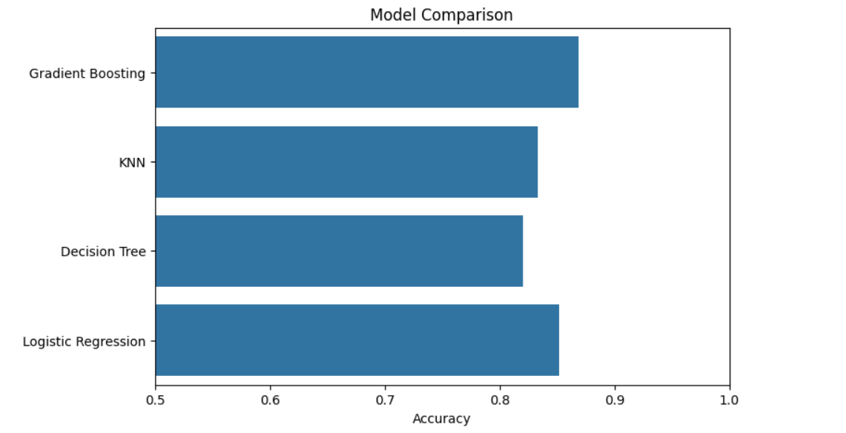

Slide 13
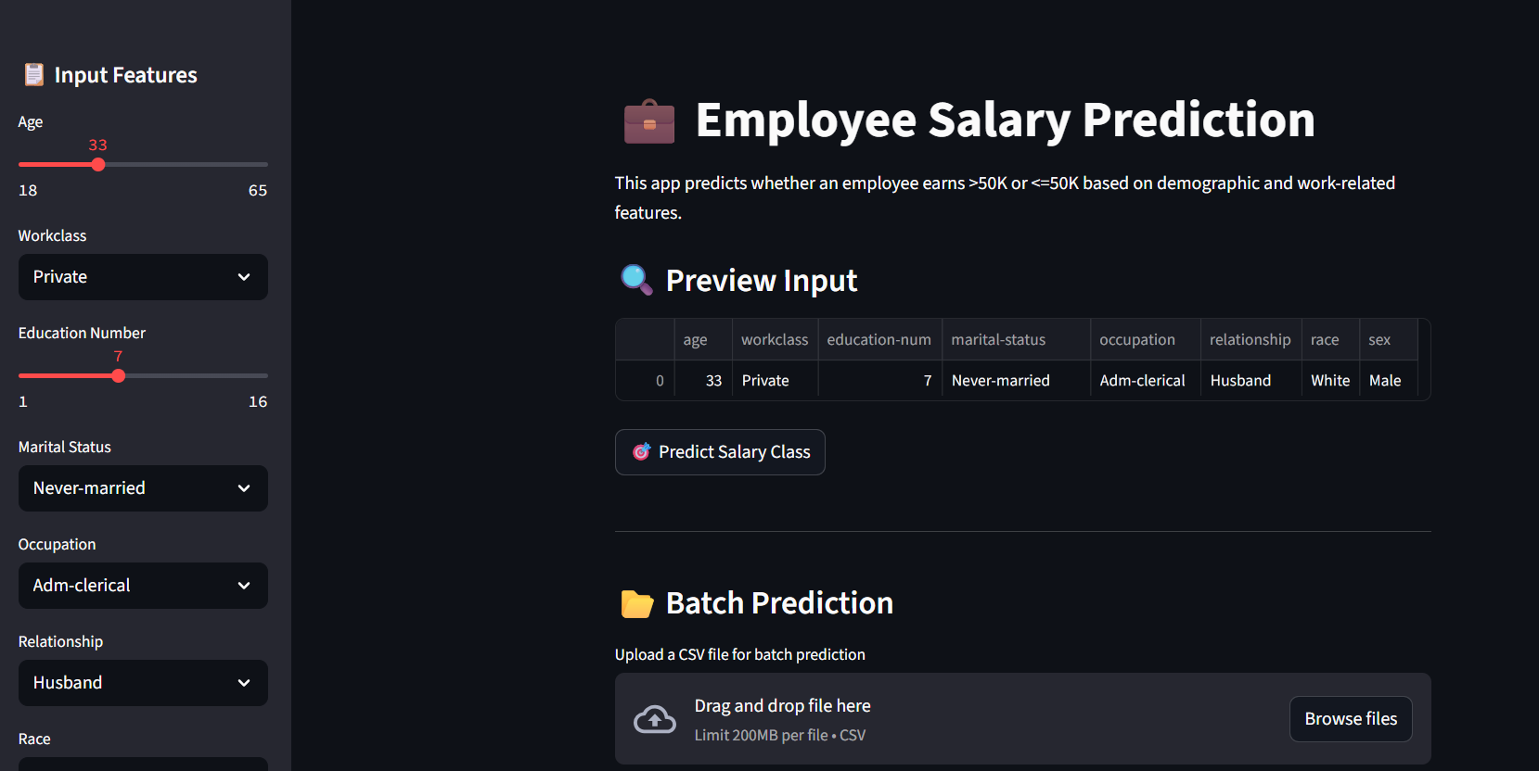

Slide 14
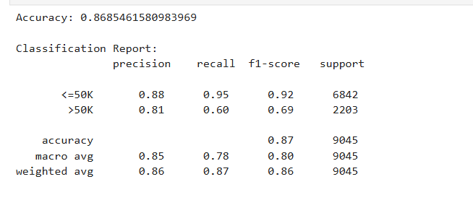
GitHub Link: https://github.com/SakarapalliPavani/employee-salary-prediction.git

Slide 15
Conclusion
In this project, a Gradient Boosting Classifier was effectively used to predict whether an employee earns more than $50K annually based on demographic and work-related features. The model achieved an accuracy of approximately 86%, outperforming simpler classifiers like KNN, Decision Tree, and Logistic Regression. Extensive data preprocessing, including handling missing values, encoding categorical variables, and scaling numerical features, played a vital role in improving the model's performance. Exploratory data analysis through boxplots and correlation heatmaps provided valuable insights into data distribution and relationships. The trained model was then deployed using a Streamlit web application, allowing both individual and batch predictions, making the solution practical for real-world HR analytics and decision-making scenarios. This project demonstrates the power of ensemble learning and end-to-end machine learning deployment in a user-friendly format.

Slide 16
Future scope(Optional)
Try advanced gradient boosting libraries like XGBoost or CatBoost
Integrate with a web app using Flask or Streamlit
Enable real-time salary prediction for HR tools

Slide 17
References
UCI Machine Learning Repository: Adult Dataset
Scikit-learn documentation: https://scikit-learn.org
Towards Data Science articles on Gradient Boosting
GitHub examples of salary prediction models.

Slide 18
THANK YOU

